Slide 1

CONJUNTION ANALYSIS & VISUALISATION OF EARTH-ORBIT SPACE OBJECTS
MATLAB Space Situational Awareness Visualisation (MASSAV)
Joel Stuart
43203714

Slide 2
Introduction
Since 1957, the space around our earth has been becoming increasingly congested.
Over 1300 active satellites in orbit [1]
16,000 pieces of catalogued debris larger than 10cm that are being tracked [2].
In the uncatalogued / (smaller than 10cm) domain there are millions more objects that have yet to be identified.

Slide 3
Why should we care?
An impact between an active satellite & orbital debris is often critical
(2009 collision between active Iridium 33 and non-active Kosmos 2251 [3])
Space debris cannot currently be plausibly removed from orbit [4]
The current overcrowding problem is projected to escalate as additional space missions are launched [4]
Pre-existing debris collides and shatters, further compounding the problem [4].

Slide 4
Space Situational Awareness/Tracking (SSA/SST)
SSA concerned with predicting orbital object locations with objective of avoiding collisions
SST concerned with tracking and surveying threats to orbital satellite systems
SGP4 propagator (Standard General Perturbations model 4)
Predicts the effect of perturbations on near earth objects, particularly used with Two-line Element (TLE) sets.
Given input -> predict where object is at certain time
Uncertainty/error grows as propagate further into future

Slide 5
Proposal
The aim of this project is to build a program to visualise and analyse orbital object tracking data in an interactive 3D rendered environment.
It will explore non-Gaussian uncertainty of orbital objects via particle representations to convey collision risks in an intuitive and innovative way.
MATLAB Space Situational Awareness Visualisation (MASSAV)

Slide 6
Non-Gaussian Conjunction Analysis
Traditional conjunction analysis assumes the uncertainty of orbital objects will behave via a roughly Gaussian model [5, 9].
Assumption supresses the true non-Gaussian nature of orbital object position uncertainties [6, 7, 8, 9].
Using statistically weighted particle generation techniques, can model the non-Gaussian uncertainty of the any orbital object with known elements [9].

Slide 7
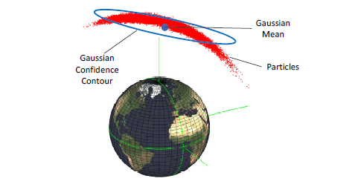
The Gaussian mean can be significantly off centre relative to the true probability density function (pdf) [9].
Figure 1 - Gaussian and particle representations of an orbital object’s uncertainty (image from [9])

Slide 8
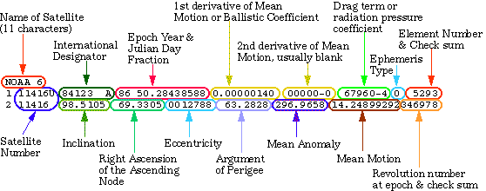
Two-line Element (TLE) Format
Figure 2 – TLE Format Layout [11]
Figure 3 – a typical TLE

Slide 9
MASSAV Methodology
TLE input
SGP4 propagator to simulate/propagate objects forward in time
Particle representation of uncertainty (add noise to elements of sgp4 model)
Collision analysis on bodies that pass within certain distance
Simulated scenarios for verification/development in reduced scope
Collision analysis on large TLE catalogue set
Notes:
This project will use Two Line Element (TLE) datasets from publically available SST catalogues using sources such as SpaceTrack [18] to achieve snapshots of real satellites and orbital debris. It will use the high-level MATLAB computing language and calculation environment to investigate the collision analysis domain in both simulated scenarios and on SST catalogues for real world applications. The reduced scope of generated scenarios will support the verification and testing of functionality to speed up the development process.
Particle representations that model uncertainty be generated by adding noise to each orbital element of each object in the problem space, using co-efficient parameters specified in [11].
To achieve smooth interactive visualisations without compromising accuracy of simulation or suffering from processing bottlenecks, the project will support both real time and pre-rendered options, GPU utilisation for parallelisation (natively supported by MATLAB)[11] and filtering algorithms to narrow the problem space for conjunction analysis purposes [6, 9, 11, 13]. Rendered simulations will able to be saved for later use and will allow iterative analysis and filtering to be performed.
To facilitate interaction with the 3D environment, keyboard, mouse and GUI controls will give the user options to explore and analyse the problem space.

Slide 10
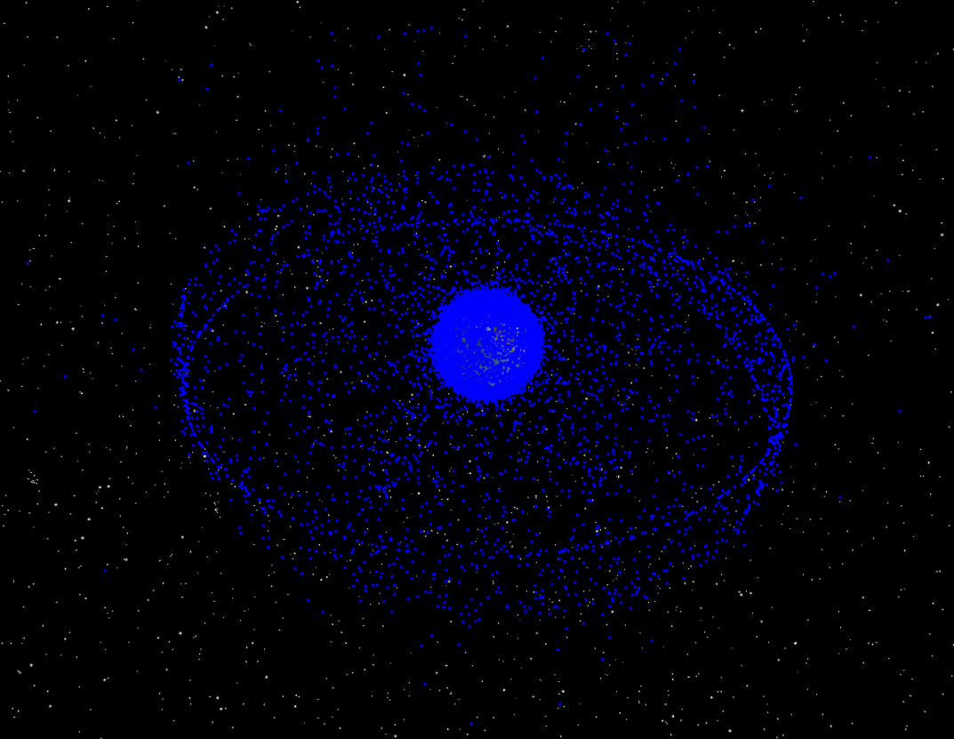
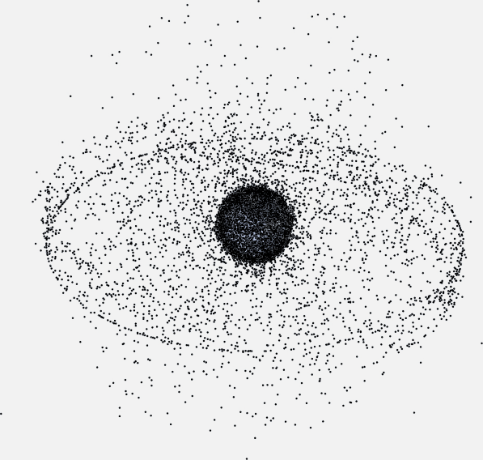
Progress?
Figure 4- NASA graphic of orbital debris around earth (image from [12])
Figure 5 MASSAV screenshot on publicly available full space catalogue TLE [13]

Slide 11
(demonstration)

Slide 12
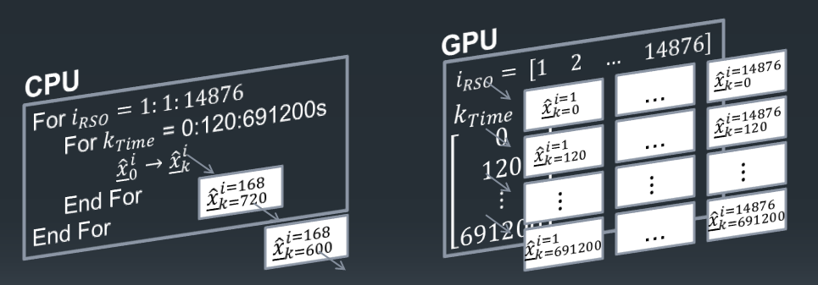
NVIDIA CUDA (GPU) Processing
Large dataset of objects x time (frames) …x particles (for conjunction analysis)
For example:
Figure 6 – in-series processing (CPU) vs. parallel processing (GPU)
(image from [14])

Slide 13
GPU Processing (in short)
MATLAB host process
Send data to GPU (arrays of objects, times, etc.)
Perform operations in parallel GPU environment (CUDA)
Retrieve propagated position results from GPU

Slide 14
Benchmarks
Table 1 – calculation times of MASSAV CPU/GPU routines at different sizes
Benchmark | 1 Frame | 10 Frames | 100 Frames | 1,000 Frames
CPU: 15500 objects | 1 min 42 s | 1 min 54 s | 4 min 31 s 3 min 29s (~78 frames) | 23 min 42s
GPU: 15500 objects | 13.1s | 13.3s | 15s (~78 frames) | NaN
CPU: 2200 objects | 4.3s | 5.8s | 32 s | 2 min 56s
GPU: 2200 objects | 1.7s | 1.7s | 1.7s | 3.0s
CPU: 333 objects | 0.692s | 0.953s | 3.154s | 26.85s
GPU: 333 objects | 0.292s | 0.296s | 0.304s | 0.413s
CPU: 24 objects | 0.133s | 0.154s | 0.301s | 1.993s
GPU: 24 objects | 0.050s | 0.050s | 0.054s | 0.058s
Current GPU implementation runs out of memory around 15,500 obj x 80 frames = 1,240,000 frames
Bonus GPU: 24 obj x 80,000 frames = 1,920,000 frames ->0.51s

Slide 15
Current limitations of GPU Processing
Crashes when working with >1,240,000 frames
Running out of memory on GPU (using 2GB of laptop GPU)
Solution would be: split up calculations on large datasets into chunks to run in series on GPU. Further optimisation

Slide 16
Future Plan
Uncertainty volumes / particles
Conjunction (collision) analysis in closed scenario
Iterative / reductive analysis on real datasets
Interactivity, automation and user options
Explore 3D visualisation methods

Slide 17
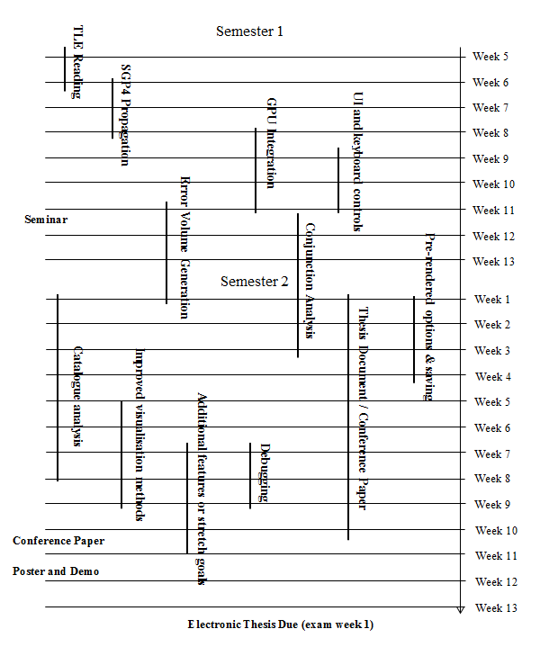
Development Plan
Figure 7 – breakdown of development milestones

Slide 18
References
[1] Union of Concerned Scientists, “Colliding Satellites”, Accessed May 19, 2016, URL: http://www.ucsusa.org/nuclear-weapons/space-security/colliding-satellites
[2] Allianz Global Corporate & Speciality, “Space Risks: A new generation of challenge”, (2012)
[3] T.S. Kelso, “Analysis of the Iridium 33-Cosmos 2251 Collision”, Centre for Space Standards & Innovation, (2009)
[4] U.S. Congress, Office of Technology Assessment, “Orbiting Debris: A Space Environmental Problem-Background Paper”, (September 1990), OTA-BP-ISC-72, Washington, DC: U.S. Government Printing Office
[5] – S. Alfano, “Review of Conjunction Probability Methods for Short-term Encounters”, (2013), American Institute of Aeronautics and Astronautics
[6] - R.W. Ghrist ,D. Plakalovic, “Impact of Non-Gaussian Error Volumes on Conjunction Assessment Risk Analysis”, (2012), a.i. Solutions, Inc., Colorado Springs, CO 80915
[7] - Y Jianjun, Z Jianqiu, Z Zesen, “Gaussian Sum PHD Filtering Algorithm for Nonlinear Non-Gaussian Model”, (2008), Department of Electronic Engineering, Fudan University, Shanghai 200433, China
[8] - G. Terejanu, P. Singlay, T. Singhz, P.D. Scottx, “Uncertainty Propagation for Nonlinear Dynamical Systems using Gaussian Mixture Models, (2008), American Institute of Aeronautics and Astronautics
[9] – T. Hobson, - “Sensor Management for Enhanced Catalogue Maintenance of Resident Space Objects”, (2014), The University of Queensland, Section 6.2

Slide 19
[10] – X. Xu, Y. Xiong, “A Method for Calculating Collision Probability between Space Objects”, (2013)
[11] NASA, “Definition Two-line Element”, Retrieved May 19th, 2016, URL: http://spaceflight.nasa.gov/realdata/sightings/SSapplications/Post/JavaSSOP/SSOP_Help/tle_def.html
[12] NASA Orbital Debris Program Office, “Orbital debris – Graphics”, (2009, July). , Accessed April 1, 2016, URL: http://orbitaldebris.jsc.nasa.gov/photogallery/beehives.html
[13] Scitor Corporation, “Space Track Data Catalogue”, Retrieved April 5th, 2016, URL: https://www.space-track.org/
[14] T. Hobson, “MATLAB + GPU = Efficient Mini Supercomputer”, Lecture Slides, Slide 4.

Slide 20
Q & A

